Slide 1

CLASS Simulations Vertical Subsidence Velocity
Atmospheric Simulations
Nadia Kairaktidi
1068622

Slide 2
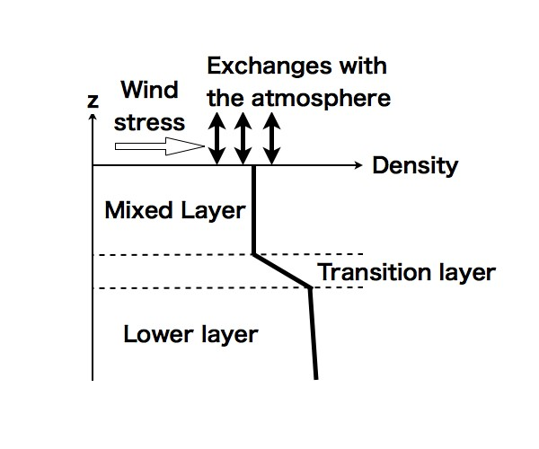
Mean vertical subsidence velocity: from weak to strong high-pressure systems
Closely linked to the presence of high-pressure systems is large-scale vertical motion. This vertical motion is related to the horizontal wind divergence, as high pressure systems create slow downward vertical motion called subsidence. The presence of subsiding motions also influences the boundary layer development as the lapse rate is an effect of the large synoptic scales on the ABL. In problems where we are dealing with dynamic changes in properties at the exchange zone, we need to account for the potential contribution of vertical transport due to the large-scale motions driven by the mean subsidence velocity wₛ.

Slide 3


The entrainment process represented by w΄θ΄ₑ is defined as the process whereby air with heat properties from the free atmosphere is mixed into the mixed layer, and it is therefore related to the jump at the inversion. We assume that the inversion is represented by a sharp discontinuity, namely, the zero-order jump closure (ZOJ). Therefore, the entrainment process can be described by the following equation :
By rewriting this, we obtain an expression of the boundary layer growth as a function of the entrainment flux
This equation states that the mixed layer grows by entrainment of warm air from the free atmosphere (wₑ > 0), and it is opposed by the vertical velocity subsidence (wₛ < 0) driven by high pressure situations. This growth is limited by the presence of a stably stratified layer defined by a potential temperature jump at the CBL top. This jump at the inversion, represented by Δθₕ = θₕ₊ - <θ>, changes during the growth and evolution of the mixed layer. Consequently, depending on a positive or negative tendency, the boundary layer growth increases or decreases.

Slide 4

Mean vertical subsidence velocity: from weak to strong high-pressure systems
In our model, regarding the mixed-layer theory, we calculate the subsidence velocity as :
where wₛ is the large-scale subsidence velocity (units m s ⁻¹) that is a function of the horizontal wind divergence in s⁻¹, where Uₕ is the horizontal mean wind. Large-scale high-pressure systems are characterized by positive Div (Uₕ) and therefore negative wₛ as we will see in the following graphs.
Typical values of Div (Uₕ) are on the order of 10⁻⁵ s⁻¹ . By using the above expression, we obtain subsidence velocities that are of similar order to the entrainment velocity wₑ (cm s⁻¹). To study the role of the vertical subsidence velocity, we first set a situation with three different values of subsidence, one where Div (Uₕ) is equal to 10⁻⁵ s⁻¹ (weak divergence), one where Div (Uₕ) is equal to 5*10⁻⁵ s⁻¹ (strong divergence) and one for zero divergence. Employing the above, we plot the subsidence velocity as a function of height to find its dependence on it. We repeat this process for both diurnal and non-diurnal cycles.

Slide 5
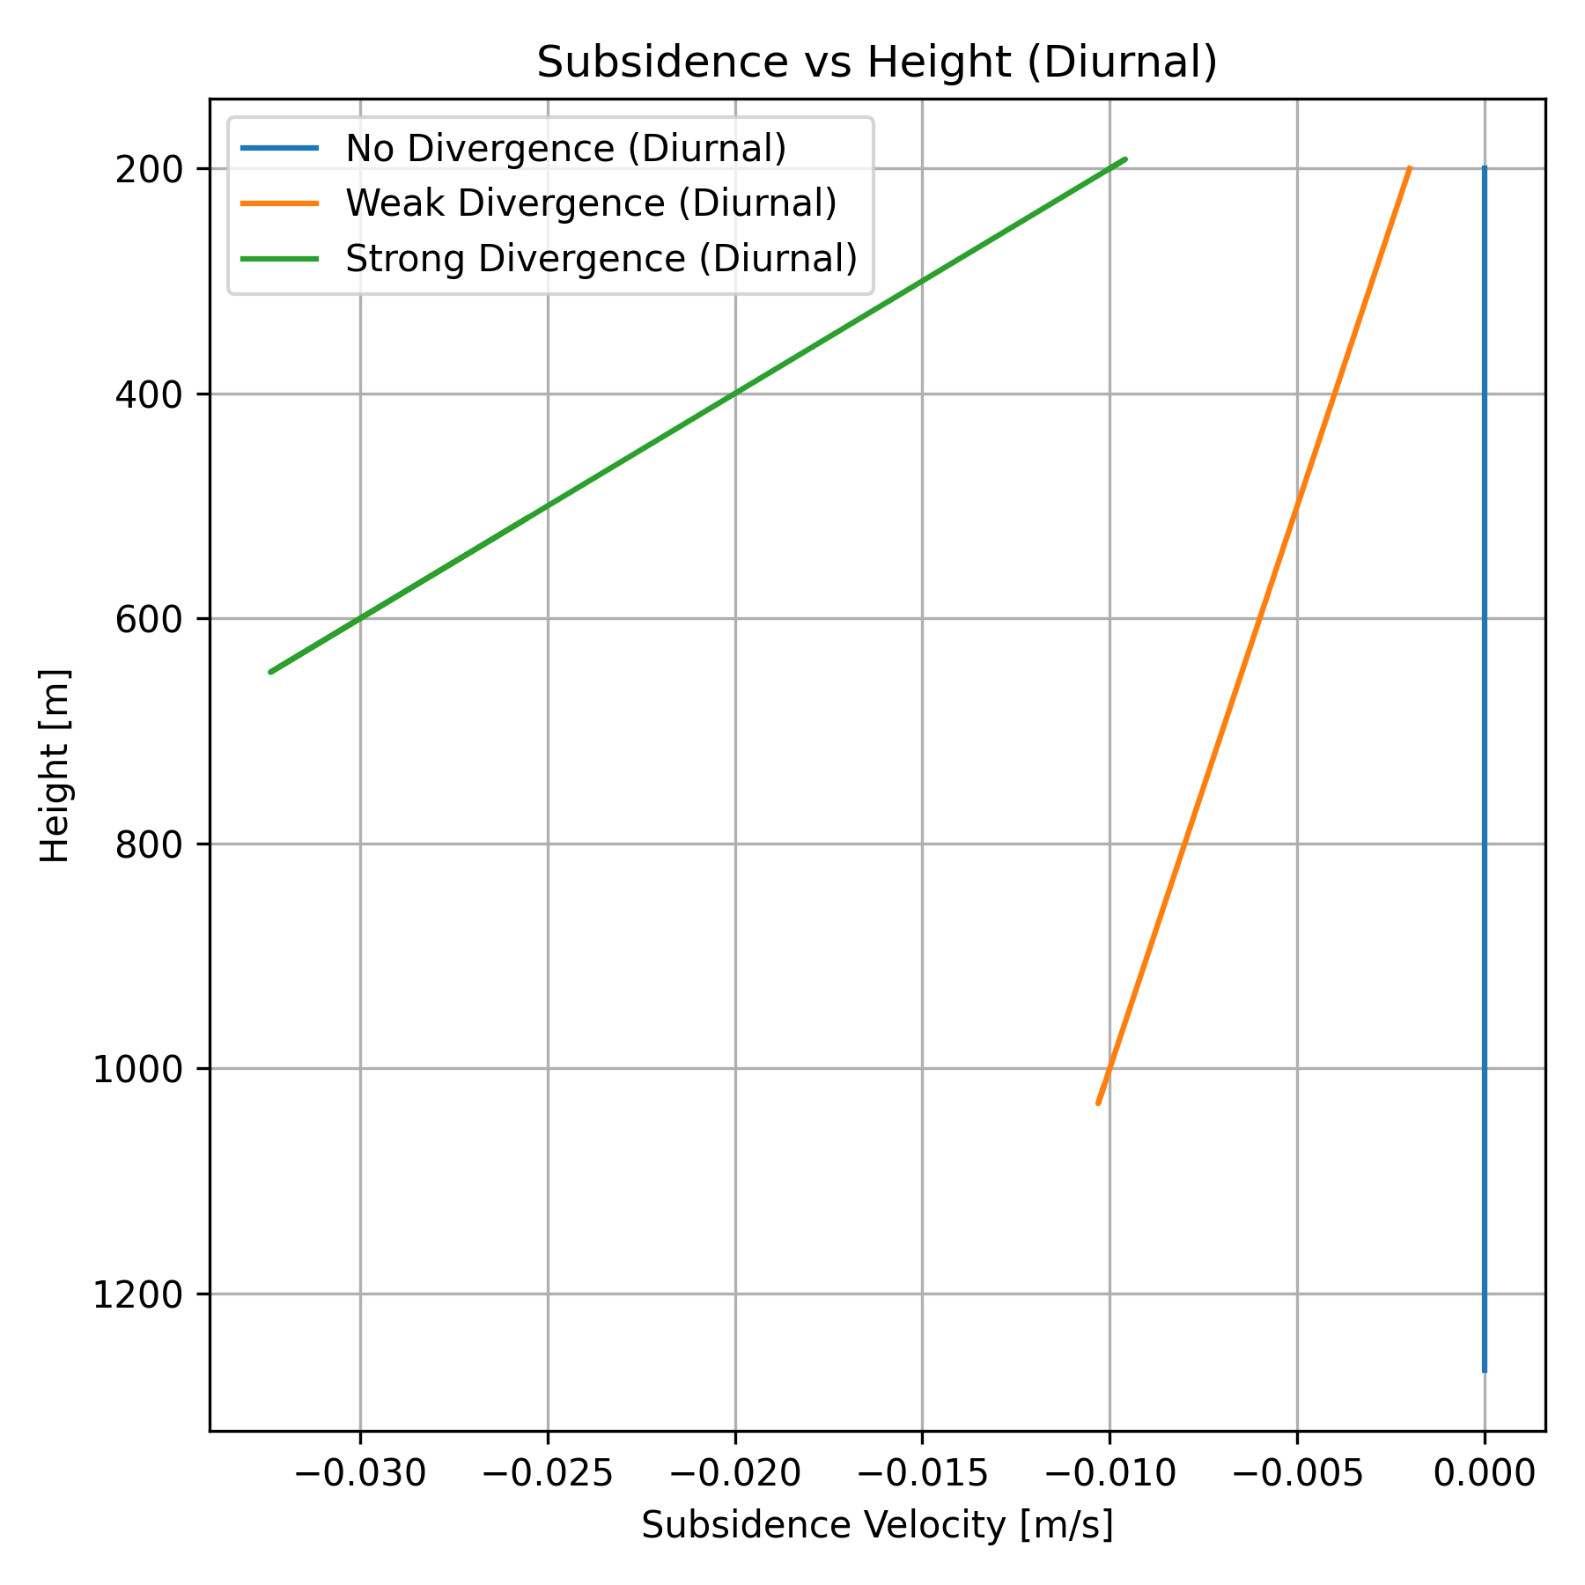
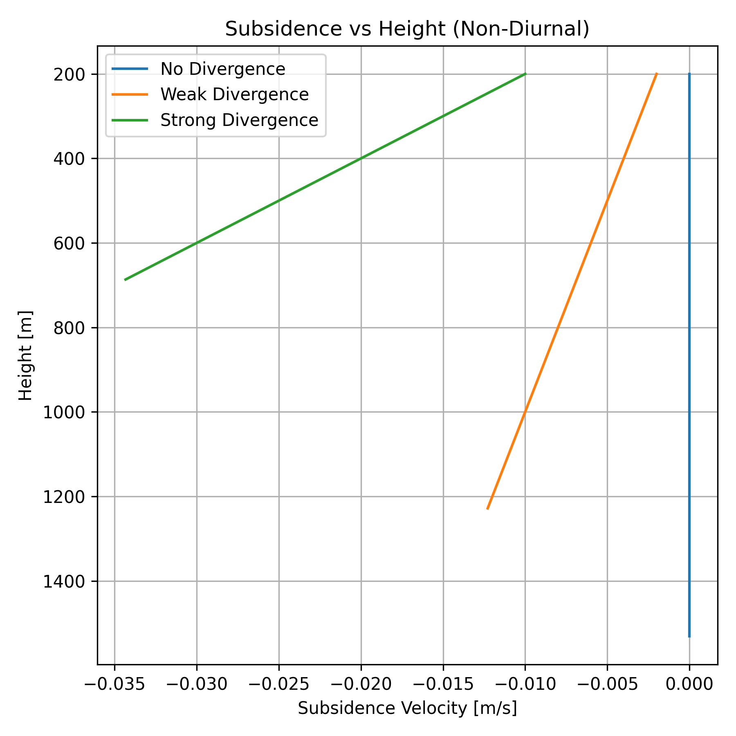

Slide 6
From the previous graphs it is obvious that
The boundary layer height decreases as subsidence increases and
Increasing divergence, meaning stronger high-pressure systems, leads to stronger subsidence thus lower boundary layer height.
The diurnal cycle does not seem play a major role in the dependence of the subsidence on the boundary layer height.
Next, we focus on comparing the boundary layer characteristics in a situation without subsidence and in two other cases where it is being influenced by the presence of a high-pressure system, a weak one and a strong one. The characteristics that we choose to study are the mean potential temperature θ, the potential temperature jump Δθ and the boundary layer height h.

Slide 7
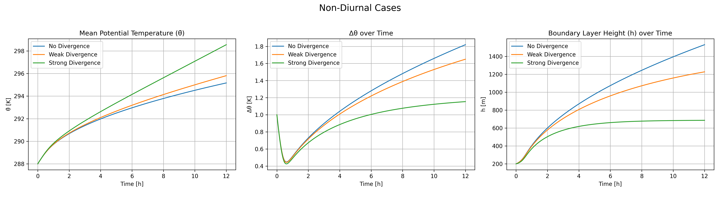
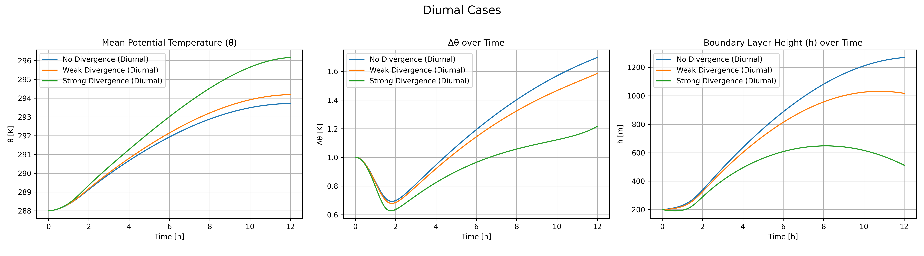

Slide 8
Parameter | Non-Diurnal Case | Diurnal Case | Key Differences & Similarities
Mean Potential Temperature (θ) | - Steady, continuous increase due to constant heating. - Strong divergence causes highest θ due to suppressed mixing. | - θ increases more rapidly in the morning, then slows as the day goes on. - Strong divergence also leads to highest θ. | ✔ Same divergence effects in both cases. ✘ Diurnal has more curvature and lower final θ due to limited heating.
Potential Temperature Difference (Δθ) | - Initial dip followed by a sustained increase. - Strong divergence results in smaller Δθ due to mixing suppression. | - Similar initial dip; Δθ increases rapidly in the morning then flattens. - Divergence again limits Δθ growth. | ✔ Both show divergence reduces Δθ. ✘ Diurnal Δθ is once again lower.
Boundary Layer Height (h) | - Gradual increase; deepest growth happens without divergence (~1500 m). - Strong divergence caps h earlier (~700 m). | - Rapid morning growth, peaking before midday (~1250 m max). - Strong divergence suppresses h significantly (~600 m). | ✔ Divergence limits h in both. ✘ Diurnal h peaks earlier and declines or plateaus due to reduced heating.

Slide 9
Lastly, we find a situation where the boundary layer growth is 0 meaning that the derivative of the height h with time is equal to zero. From the above analysis, we understand that this leads to the entrainment velocity wₑ to be equal the large-scale subsidence velocity wₛ.
Minimal Mixing: When subsidence and entrainment velocities are nearly equal, the boundary layer might not be growing vertically, and the interaction between the boundary layer and the free atmosphere might be reduced. If both velocities are close to each other, there is minimal vertical motion or mixing, leading to a more stable atmospheric profile.
The entrainment heat flux :
Entrainment Flux: In a situation with no difference between subsidence and entrainment velocities, it could indicate a situation where the entrainment flux is negligible or balanced. This means that the boundary layer is not actively exchanging air with the free atmosphere, and this could lead to a stable or nearly stagnant boundary layer.
The entrainment flux is just maintaining the current boundary layer height — no growth occurs. Vertical mixing still happens, but it is limited to compensating the subsidence, not driving expansion of the mixed layer. Surface heating is not strong enough to overcome the downward motion from the high-pressure system.

Slide 10
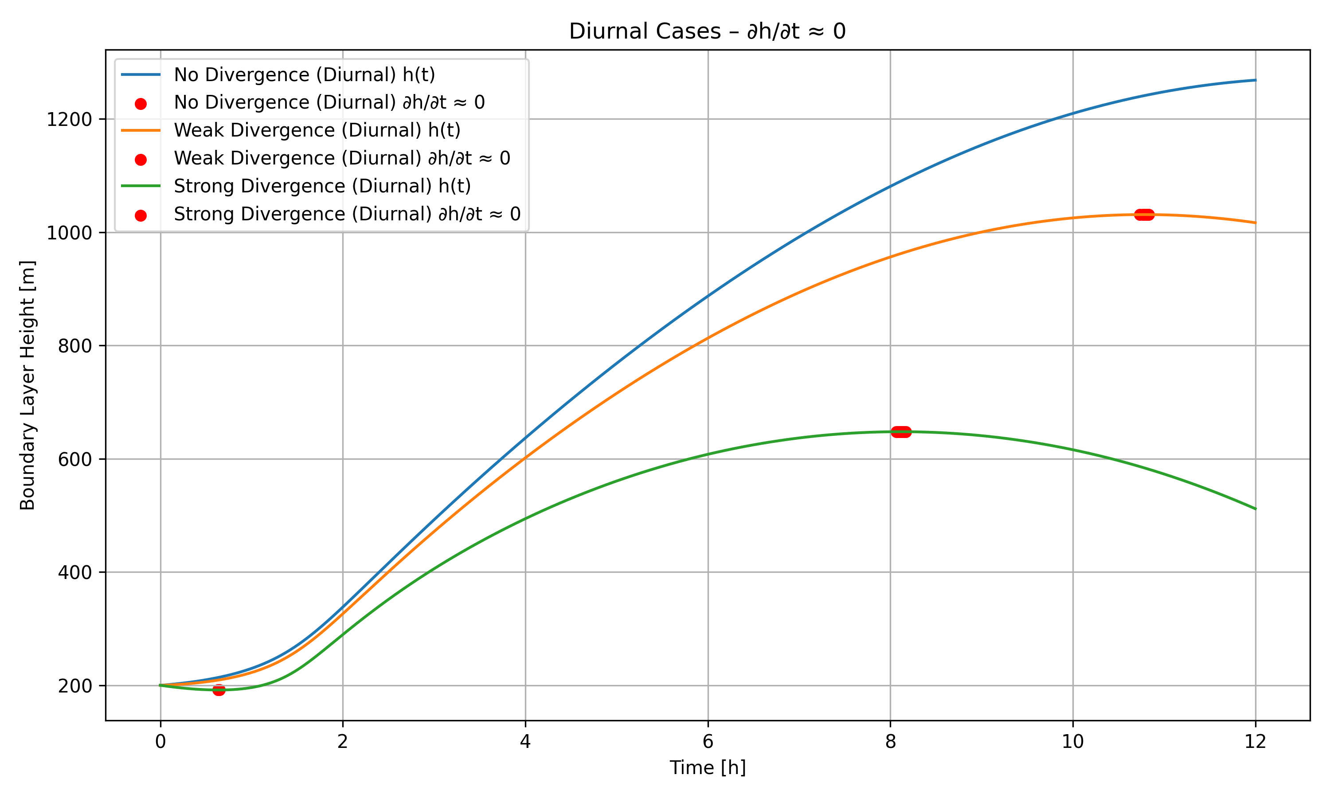

Slide 11
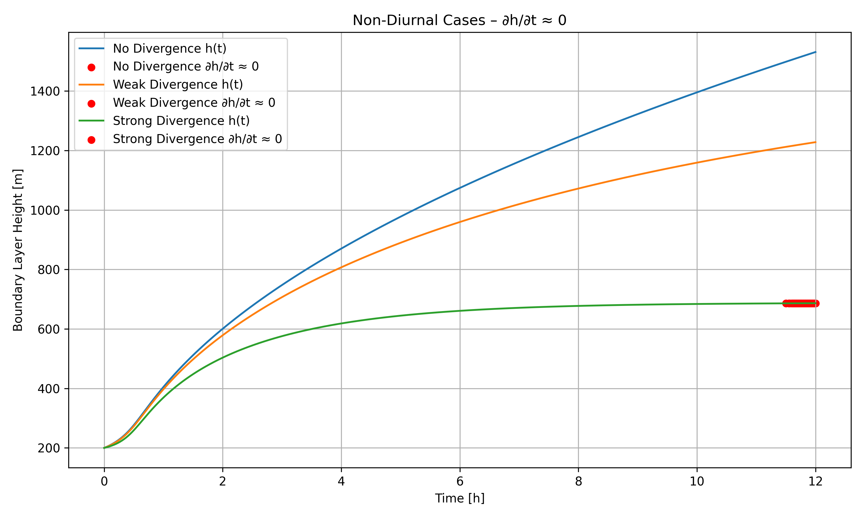

Slide 12
Boundary Layer Characteristics when ∂h/∂t = 0
Constant Boundary Layer Height: The mixed-layer depth h remains constant throughout the simulation. This indicates a balance between upward entrainment and downward subsidence.
Suppressed Vertical Mixing: The vertical mixing is less vigorous due to the reduced or absent buoyant convection (e.g. from surface heating). Vertical transport of heat, moisture, and momentum is limited.
Capped Entrainment Zone: Entrainment still occurs but only maintains the current ABL height. The inversion layer at the top remains strong or may intensify.
Stable or Weakly Unstable Conditions : Vertical temperature gradients near the inversion stay sharp. Stratification remains stable, especially under clear-sky, high-pressure conditions.
Poor Ventilation : Pollutants, moisture, or heat introduced near the surface are trapped. Air quality may deteriorate due to stagnation.
Energy Budget : Surface sensible heat flux is mostly balanced by turbulent mixing within the fixed-depth layer, not by growth. Turbulent kinetic energy may be low due to weak forcing.
This is typical under persistent high-pressure systems with clear skies and light winds. Pollutants can accumulate, and diurnal temperature ranges may increase due to poor mixing. The boundary layer becomes shallow and capped, leading to stable and often hazy atmospheric conditions.

Slide 13
Conclusion
This study demonstrates the significant impact of vertical subsidence velocity on boundary layer development under varying high-pressure conditions.
Stronger high-pressure systems, indicated by higher divergence values, lead to enhanced subsidence and a suppressed boundary layer height.
This suppression of vertical mixing limits the exchange of heat, moisture, and momentum between the surface and the free atmosphere. As a result, surface temperatures can become more extreme—warmer during the day and cooler at night—due to the lack of convective mixing, while potential temperature gradients near the inversion remain sharp.
When subsidence balances entrainment, vertical mixing becomes minimal, resulting in a stable boundary layer and limited atmospheric exchange.
These findings emphasize the crucial role of large-scale dynamics in shaping boundary layer characteristics and highlight the potential implications for air quality, energy budgets, and weather forecasting under persistent high-pressure systems.

Slide 14


